Slide 1


Slide 2
Use of climate projection data to assess future vulnerability to develop adaptation plan
Aradhana Yaduvanshi
Watershed Organisation Trust
Pune

Slide 3
Climate Projections at regional level
Fine spatial resolution data
CMIP-5
Spatial Resolution
(2.5*2.5 °)
20 Modeling group
4 GHG Emission Scenarios
?
Adaptation planning at Regional level (Block level or District level

Slide 4
Fine Spatial Resolution Data
How to get…
Run (General circulation model) GCM at a finer resolution
Downscale the data
Run a Regional climate model (RCM)

Slide 5
Projected climate data at regional level
From application point of view, two sources of data accessed:
  CORDEX South Asia data (0.5×0.5°)
  NEX-GDDP (0.25×0.25°)

Slide 6
NEX-GDDP Data Analysis – Case of Bhokardhan block in Jalna district
Comparison of Rainfall data for Bhokardhan block in Jalna district
Long-term Monthly Average
Annual Average

Slide 7
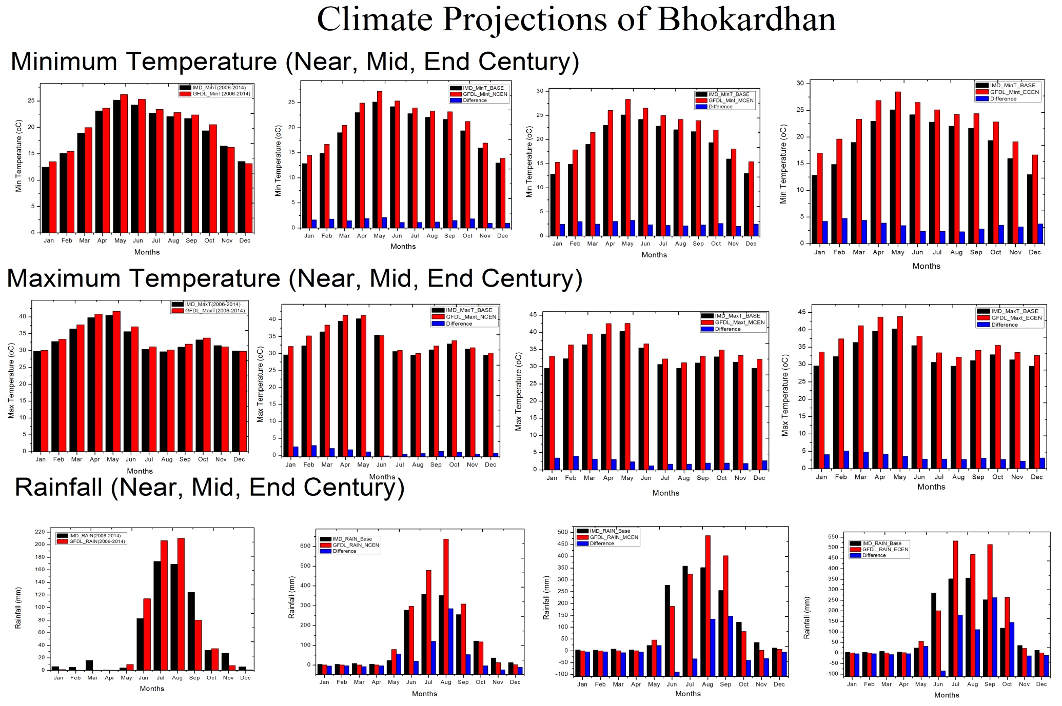

Slide 8
Key Inferences
 | Base Period (1985-2014) | Near Century (2016-2040) | Mid Century (2041-2070) | End Century (2071-2100)
Min Temp Change (°C) | 19.11 | +1.8 | +2.91 | +3.76
Max Temp Change (°C) | 33.28 | +1.08 | +2.32 | +3.22
Rainfall % change | 675.24mm | +13.77 | +13.60 | +26.50
Increase in minimum temperature higher then Maximum Temperature

Slide 9
No long term trend observed in temperature and precipitation for near century and end century
Positive trend observed in minimum and maximum temperature for mid century
Change in minimum and maximum temperature is significant at 5% level of Significance in all three centuries.

Slide 10

Community perceptions about Climatic risks in the block
Information collected through -- Community Driven Vulnerability Evaluation – Programme Designer (CoDrive-PD) tool, developed by WOTR:
The tool helps in documenting community’s knowledge of the local climate trends, coping responses, and history
Important climate risks as perceived by farmers from villages in Bhokardhan block:
Drought & drought like situation
Prolonged dry spells
Increased summer and winter temperatures
Unseasonal / delayed rainfall
Hailstorms

Slide 11
Major impacts
Decrease in productivity of crops
Groundwater decline
Decrease in soil moisture
Decrease in fodder resources
Increase in incidence of diseases (among livestock)
Income levels have gone down
Key question -- Can climate projections help in developing appropriate strategies to minimize risks and maximize opportunities?

Slide 12
Opportunities
The resolution of projected (0.25×0.25°) data is comparable to the ground data (IMD) -- which offers opportunity to study potential impact of climate change
Use of projected climate data sets to assess wet and dry spells – implications for crop and water resources management
Availability of data at daily scale -- helps in assessing and managing risks due to natural hazards such as Flood and Drought

Slide 13
Limitations
Only one point represents the whole grid which covers two or three villages – therefore data not sufficient to assess vulnerabilities and develop adaptation plans at village level
At present use of data is limited to scientific community only.

Slide 14
To Learn
How to get 5*5km resolution data to make projections at village level -- that would help in designing location specific adaptation plans
How to downscale models and generate data that can help in developing location specific projections
What criteria to be considered while choosing a model based on regional characteristics and the purpose.
How to avoid biasness in the daily data.

Slide 15
Thank You

Slide 16
Community Driven Vulnerability Evaluation (CoDRIVE)
Bhokardan, Jalna

Slide 17
Responses by people
Shift from subsistence farming to cash cropping (Onions, soybean, BT cotton, vegetables)
Extensive irrigation (lateral, deepening, farm ponds)
Excessive use of fertilisers and pesticide (to obtain better yields)
Relying on genetically modified seeds
Crop insurance, crop loans (fodder & irrigation)
Migration
Shift from indigenous cotton to BT cotton (Labour shortages, yield is high)
Sugarcane to cotton (being water intensive)
Uptake of horticulture crops
Health issues have increased

